Slide 1
2
Financial Statements, Taxes, and Cash Flow

Slide 2

Chapter 02 – Index of Sample Problems
Slide # 03 - 10 Understanding a balance sheet
Slide # 11 - 12 Market value versus book value
Slide # 13 - 18 Understanding an income statement
Slide # 19 - 20 Earnings per share
Slide # 21 - 22 Dividends per share
Slide # 23 - 24 Average tax rate
Slide # 25 - 26 Marginal tax rate
Slide # 27 - 28 Operating cash flow
Slide # 29 - 34 Net capital spending
(index continued on next slide)

Slide 3
Chapter 02 – Index of Sample Problems
Slide # 35 - 36 Change in net working capital
Slide # 37 - 38 Cash flow from assets
Slide # 39 - 41 Cash flow to creditors
Slide # 43 - 44 Cash flow to stockholders

Slide 4
3: Understanding a balance sheet
Answer these questions based on the balance sheet shown on slide # 4. Use 2005 values.
1. What is the amount of the current assets?
2. What is the amount of the long-term assets?
3. What is the amount of the current liabilities?
4. What is the amount of the long-term debt?
5. What is the amount of the stockholders’ equity?
Answers on slide # 5.

Slide 5
4: Understanding a balance sheet
WISDOM, INC.
Balance Sheets
($ in millions)
2004 2005 2004 2005
Assets Liabilities and Owners’ Equity
Cash | $ 199 | $ 203 | Accounts payable | $ 219 | $ 187
Accounts receivable | 436 | 421 | Notes payable | 193 | 546
Inventory | 504 | 497 | Total | 412 | 733
Total | 1,139 | 1,121 | Long-term debt | 470 | 533
Net fixed assets | 1,574 | 1,633 | Total | 882 | 1,266
 |  |  | Common stock and paid in surplus | 690 | 650
 |  |  | Retained earnings | 1,141 | 838
 |  |  | Total | 1,831 | 1,488
Total assets | $2,713 | $2,754 | Total liabilities and owners’ equity | $2,713 | $2,754

Slide 6

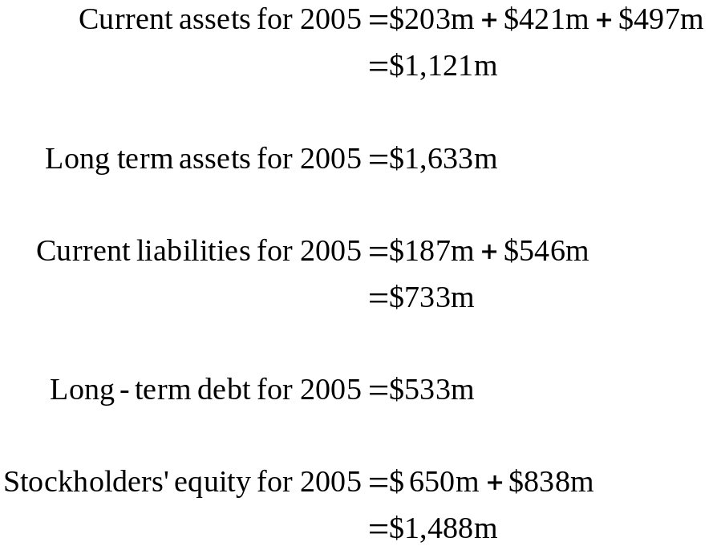
5: Understanding a balance sheet
Answers to questions from slide # 3.

Slide 7
6: Understanding a balance sheet
The Dinmore Company has total assets of $6.4 million, current assets of $2.3 million, current liabilities of $2.5 million and total liabilities of $4.2 million.
1. What is the amount of the stockholders’ equity?
2. What is the amount of the net working capital?
3. What is the amount of the long-term assets?
4. What is the amount of the long-term debt?
Answers on slides # 7-8.

Slide 8
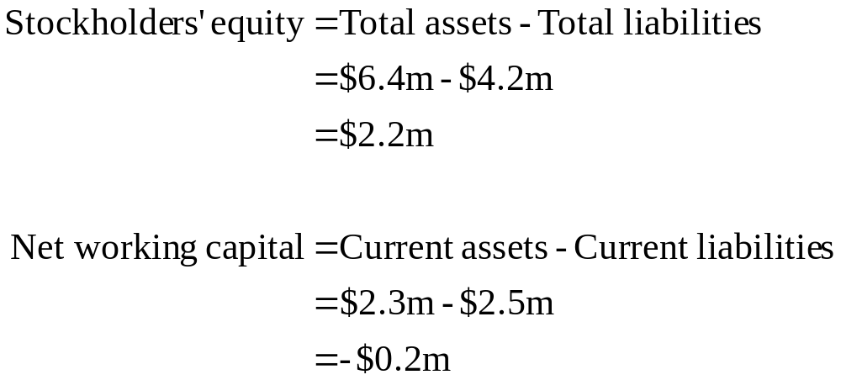
7: Understanding a balance sheet
Answers to slide # 6.

Slide 9
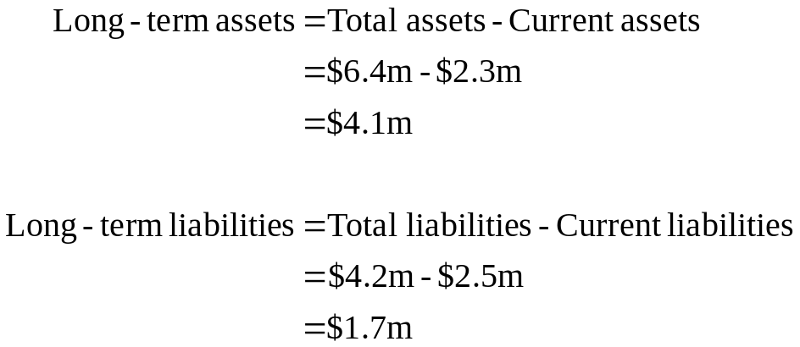
8: Understanding a balance sheet
Answers to slide # 6.

Slide 10
9: Understanding a balance sheet
Your company has current assets of $250 million, total assets of $395 million and long-term debt of $116 million. The net working capital is $19 million.
1. What is the amount of the current liabilities?
2. What is the amount of the total equity?
Answers on slide # 10.

Slide 11
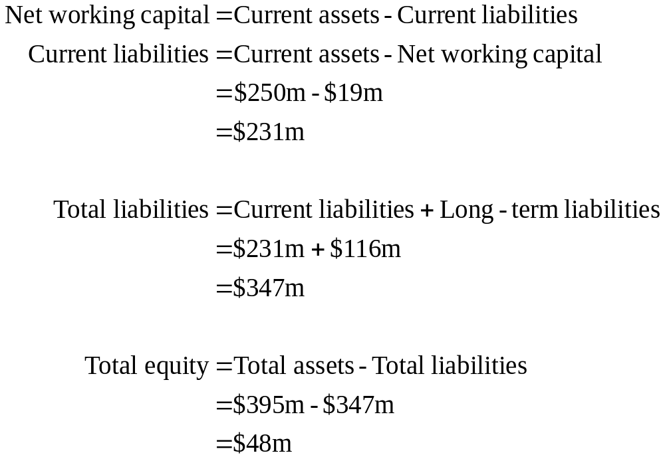
10: Understanding a balance sheet

Slide 12
11: Market value vs book value
The balance sheet of your firm shows current assets of $214,500 which includes cash of $23,600, accounts receivable of $87,500 and inventory of $103,400. Long-term assets have a book value of $487,300 which is comprised of a building and some equipment.
You believe you can sell the inventory for $163,900. You expect to collect only $84,600 of the accounts receivables. You can sell the equipment for $218,000 and the building for $365,000.
What is the total book value of your firm? The total market value?

Slide 13
12: Market value vs book value
 | Book Value | Market Value
Current assets | $214,500 | $272,100
Long-term assets | $487,300 | $583,000
Total assets | $701,800 | $855,100

Slide 14
13: Understanding an income statement
MALLORY, INC.
2005 Income Statement
($ in millions)
Net sales $2,179
Cost of goods sold 1,806
Depreciation 139
Earnings before interest and taxes ???
Interest paid 48
Earnings before taxes ???
Taxes 63 Net income $ ???
Dividends paid $ 50
Addition to retained earnings $???
Can you find the missing values?

Slide 15
14: Understanding an income statement
MALLORY, INC.
2005 Income Statement
($ in millions)
Net sales $2,179
Cost of goods sold 1,806
Depreciation 139
Earnings before interest and taxes 234
Interest paid 48
Earnings before taxes 186
Taxes 63 Net income $ 123
Dividends paid $50
Addition to retained earnings $73
Calculations shown on next slide

Slide 16
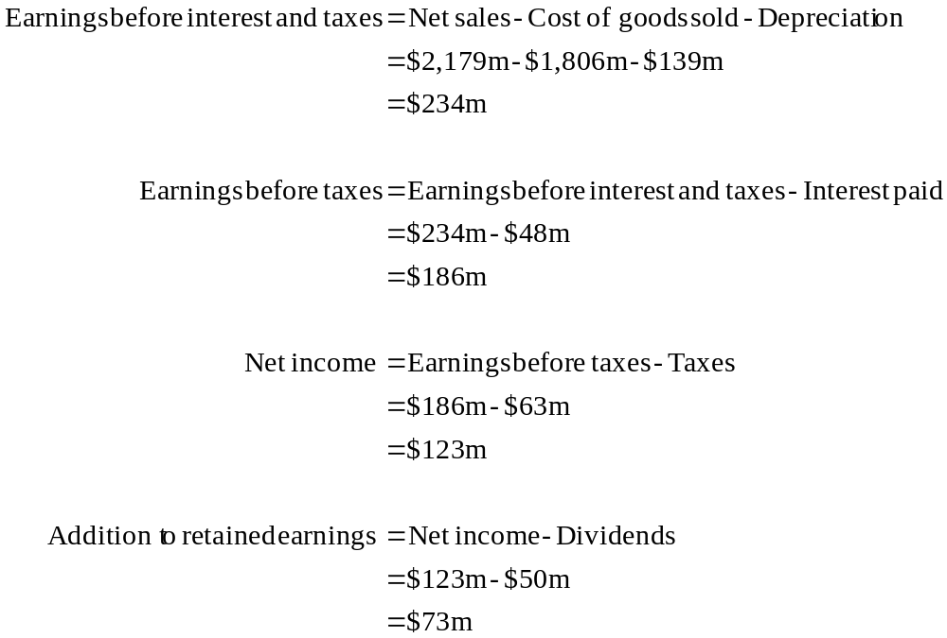
15: Understanding an income statement

Slide 17
16: Understanding an income statement
FISCHER, INC.
2005 Income Statement
($ in millions)
Net sales $1,067
Cost of goods sold 731
Depreciation 64
Earnings before interest and taxes ???
Interest paid 32
Earnings before taxes ???
Taxes ???
Net income $ ???
Dividends paid $ 35
Addition to retained earnings $ 121
Can you find the missing values?

Slide 18
17: Understanding an income statement
FISCHER, INC.
2005 Income Statement
($ in millions)
Net sales $1,067
Cost of goods sold 731
Depreciation 64
Earnings before interest and taxes 272
Interest paid 32
Earnings before taxes 240
Taxes – 35% 84
Net income $ 156
Dividends paid $ 35
Addition to retained earnings $121

Slide 19
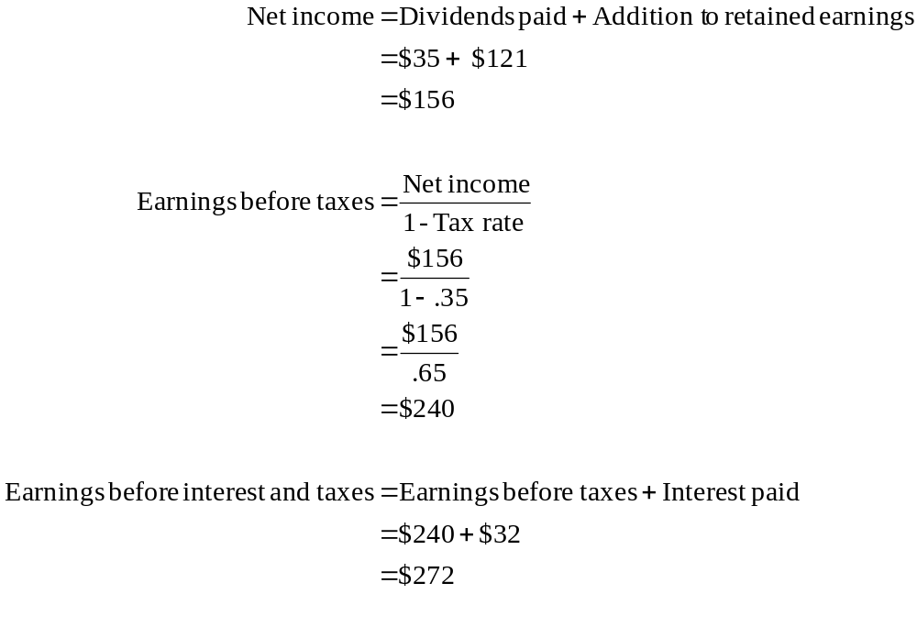
18: Understanding an income statement

Slide 20
19: Earnings per share
Your firm has net income of $210,000. You own 140,000 shares of stock and are the only stockholder.
What is the amount of your earnings per share?

Slide 21
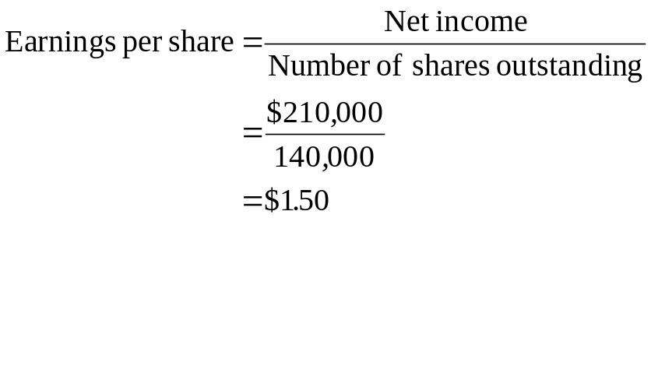
20: Earnings per share

Slide 22
21: Dividends per share
Your firm has net income of $210,000. The number of outstanding shares of common stock is 140,000. The dividend payout ratio is 40%.
What is the amount of the dividends per share?

Slide 23
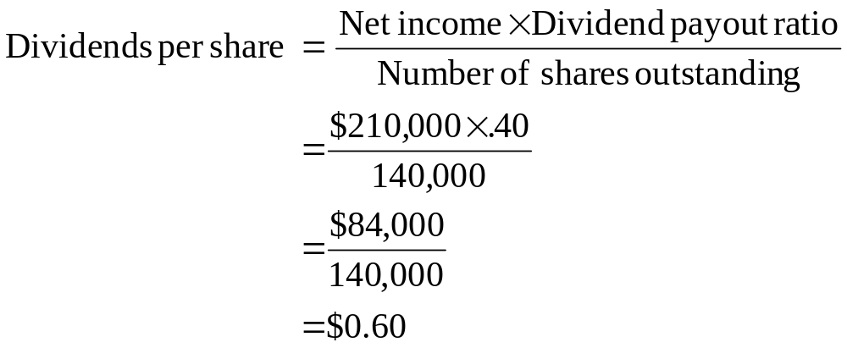
22: Dividends per share

Slide 24
23: Average tax rate
Given this tax table, what is the average tax rate for a firm with taxable income of $160,000?
Taxable Income |  | Tax Rate
0- | 50,000 | 15%
50,001- | 75,000 | 25%
75,001- | 100,000 | 34%
100,001- | 335,000 | 39%

Slide 25
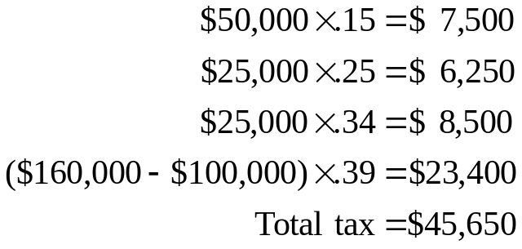
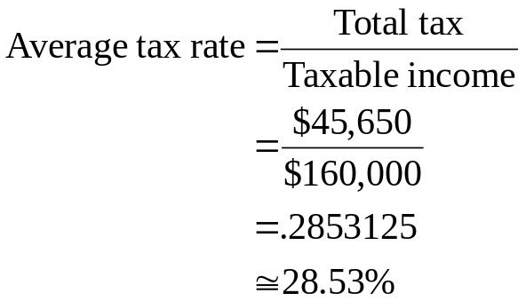
24: Average tax rate
Taxable Income |  | Tax Rate
0- | 50,000 | 15%
50,001- | 75,000 | 25%
75,001- | 100,000 | 34%
100,001- | 335,000 | 39%

Slide 26
25: Marginal tax rate
Given the information below, what is the marginal tax rate
if a firm has taxable income of $160,000?
Taxable Income |  | Tax Rate
0- | 50,000 | 15%
50,001- | 75,000 | 25%
75,001- | 100,000 | 34%
100,001- | 335,000 | 39%

Slide 27
26: Marginal tax rate
The marginal tax rate for a firm with taxable income of $160,000 is 39%. The marginal tax rate is the rate that applies to the next dollar of taxable income earned.
Taxable Income |  | Tax Rate
0- | 50,000 | 15%
50,001- | 75,000 | 25%
75,001- | 100,000 | 34%
100,001- | 335,000 | 39%

Slide 28
27: Operating cash flow
Your firm has sales of $231,800, costs of goods sold of $187,000, interest expense of $3,600, depreciation expense of $11,300 and a tax rate of 34%.
What is your operating cash flow?

Slide 29
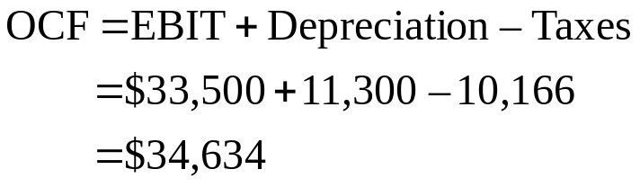
28: Operating cash flow
Sales $231,800
COGS 187,000
Depreciation 11,300
EBIT 33,500
Interest 3,600
EBT 29,900
Tax 34% 10,166
Net Income $ 19,734

Slide 30
29: Net capital spending
Your firm has ending net fixed assets of $467,803 and beginning net fixed assets of $503,498. The depreciation expense for the year is $59,200.
What is the amount of your net capital spending for the year?

Slide 31
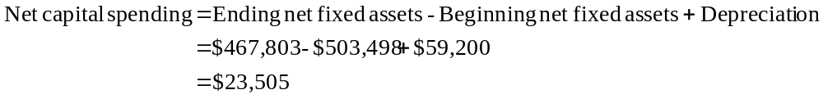
30: Net capital spending

Slide 32
31: Net capital spending
Net fixed assets, beginning $503,498
Less: Depreciation 59,200
Total 444,298
Plus: Net capital spending 23,505
Net fixed assets, ending $467,803

Slide 33
32: Net capital spending
Your firm has beginning net fixed assets of $678,407 and ending net fixed assets of $402,398. The depreciation expense for the year is $75,380.
What is the amount of the net capital spending for the year?

Slide 34
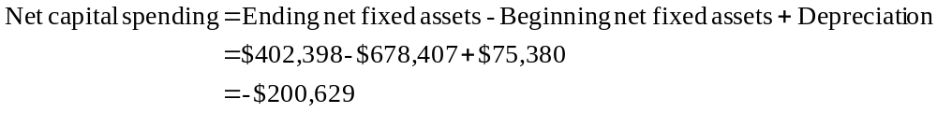
33: Net capital spending

Slide 35
34: Net capital spending
Net fixed assets, beginning $678,407
Less: Depreciation 75,380
Total 603,027
Plus: Net capital spending -200,629
Net fixed assets, ending $402,398
In this case, you had net sales of fixed assets.

Slide 36
35: Change in net working capital
Given the following information what is the change in net working capital (NWC)?
Beginning Ending
Cash $ 903 $ 789
Accounts receivable 3,298 3,672 Inventory 6,129 5,032
Net fixed assets 11,973 12,530 Accounts payable 1,542 1, 303 Long-term debt 10,200 9,300

Slide 37
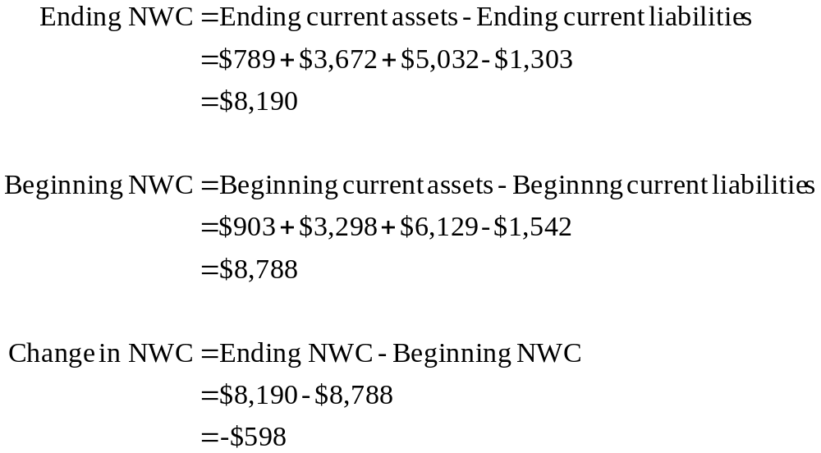
36: Change in net working capital

Slide 38
37: Cash flow from assets
A firm has operating cash flow of $18,500, change in net working capital of $300 and additions to net capital spending of -$1,200.
What is the amount of the cash flow from assets?

Slide 39
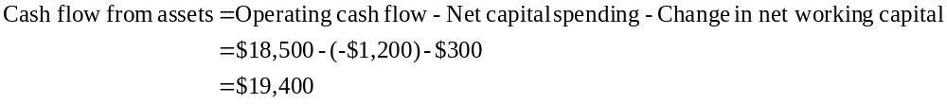
38: Cash flow from assets

Slide 40
39: Cash flow to creditors
loan
Company
Creditors
interest
loan repayment

Slide 41
40: Cash flow to creditors
Your firm has long-term debt of $42,900 as of year end. Your beginning long-term debt was $38,900. During the year, the company paid a total of $3,500 in interest.
What is the amount your cash flow to creditors?

Slide 42
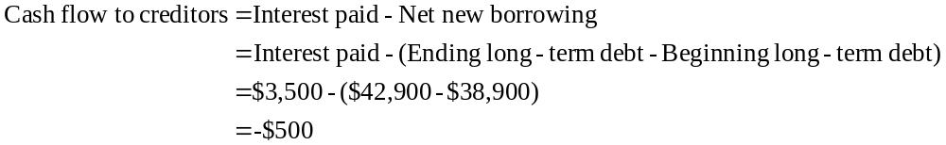
41: Cash flow to creditors

Slide 43
42: Cash flow to stockholders
sale of stock
Company
Stockholders
dividends
stock repurchase

Slide 44
43: Cash flow to stockholders
Your firm has a net income of $136,800 for the year. The dividend payout ratio is 50%. The balance sheet shows an ending common stock balance of $800,000 and an ending paid in surplus balance of $400,000. The beginning common stock balance is $750,000 and the beginning paid in surplus balance is $350,000.
What is the amount of your cash flow to stockholders?

Slide 45
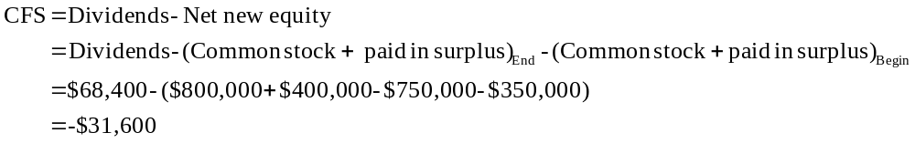
44: Cash flow to stockholders

Slide 46
2
End of Chapter 2

